Slide 1
21SW109
Beverage Ordering System
Aashish Kumar

Slide 2
INTRODUCTION
This Program has been Created as a semester project for my class of
Object Oriented Programming in Software Engineering. It is a Beverage
Ordering System that print the receipt after Ordering. The features Implemented are the following:
Swing GUI for Usability.
Threading for Cart Management.
Filing for Printing the Receipt.

Slide 3
It Has the following Classes
01
02
Main
03
Cart
Drink(Water,Juice,etc.)
Beverages
This is used to create the main class and intiliaze the components for the UI
This is the parent Class for the all four Drink classes
04
This is a thread that is Responsible for creating the Receipt
These are used to Setup and Control the UI of all the Drinks

Slide 4
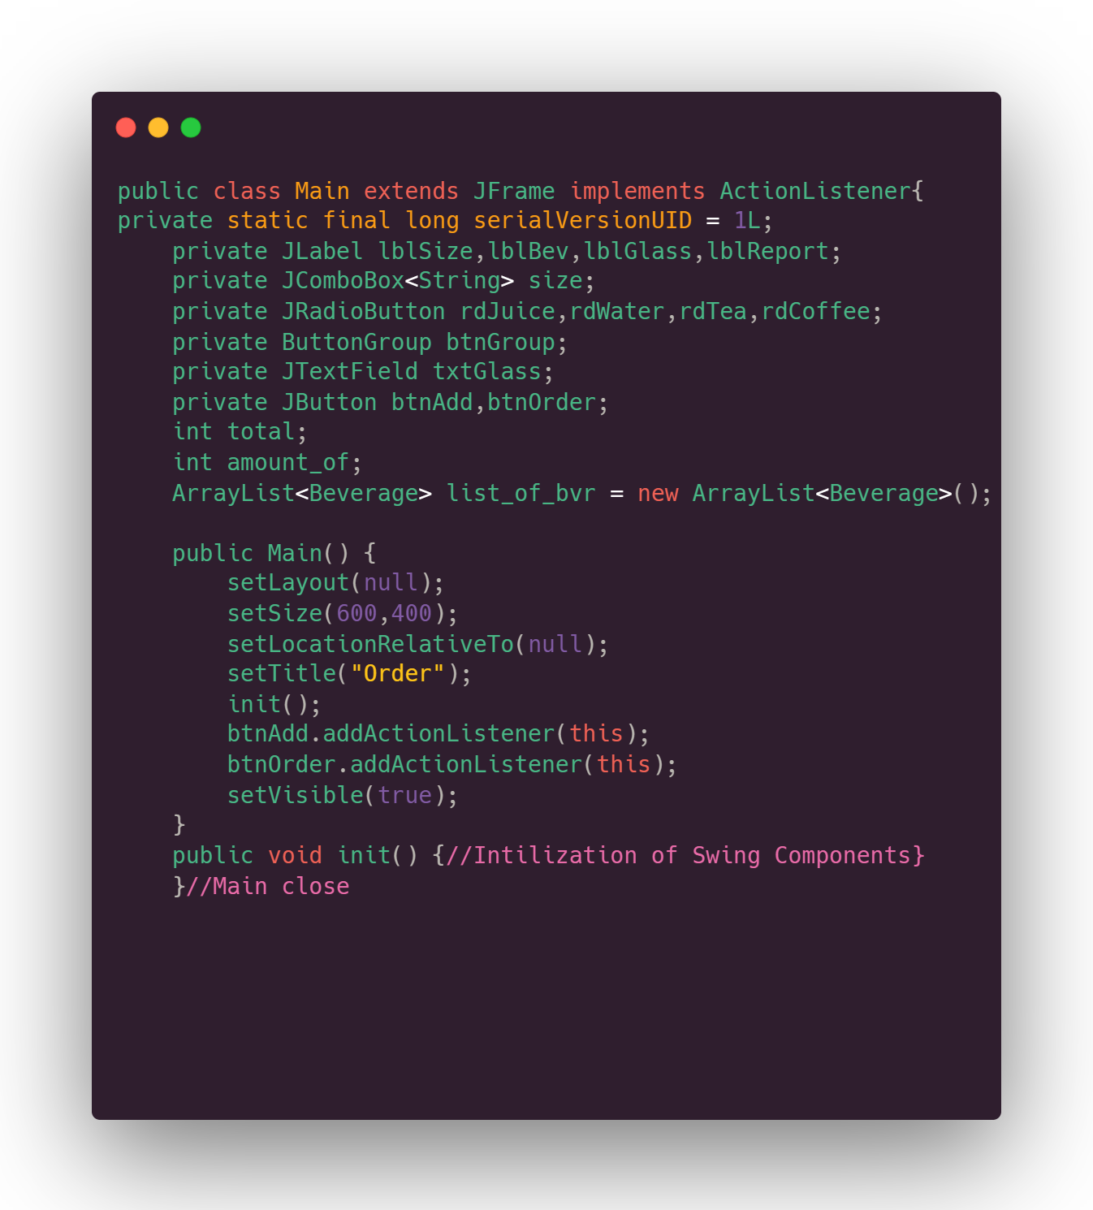
01
Main Class
Here we set the UI of our Main Frame and Initialize the components and variables we are going to need throughout our Program.

Slide 5
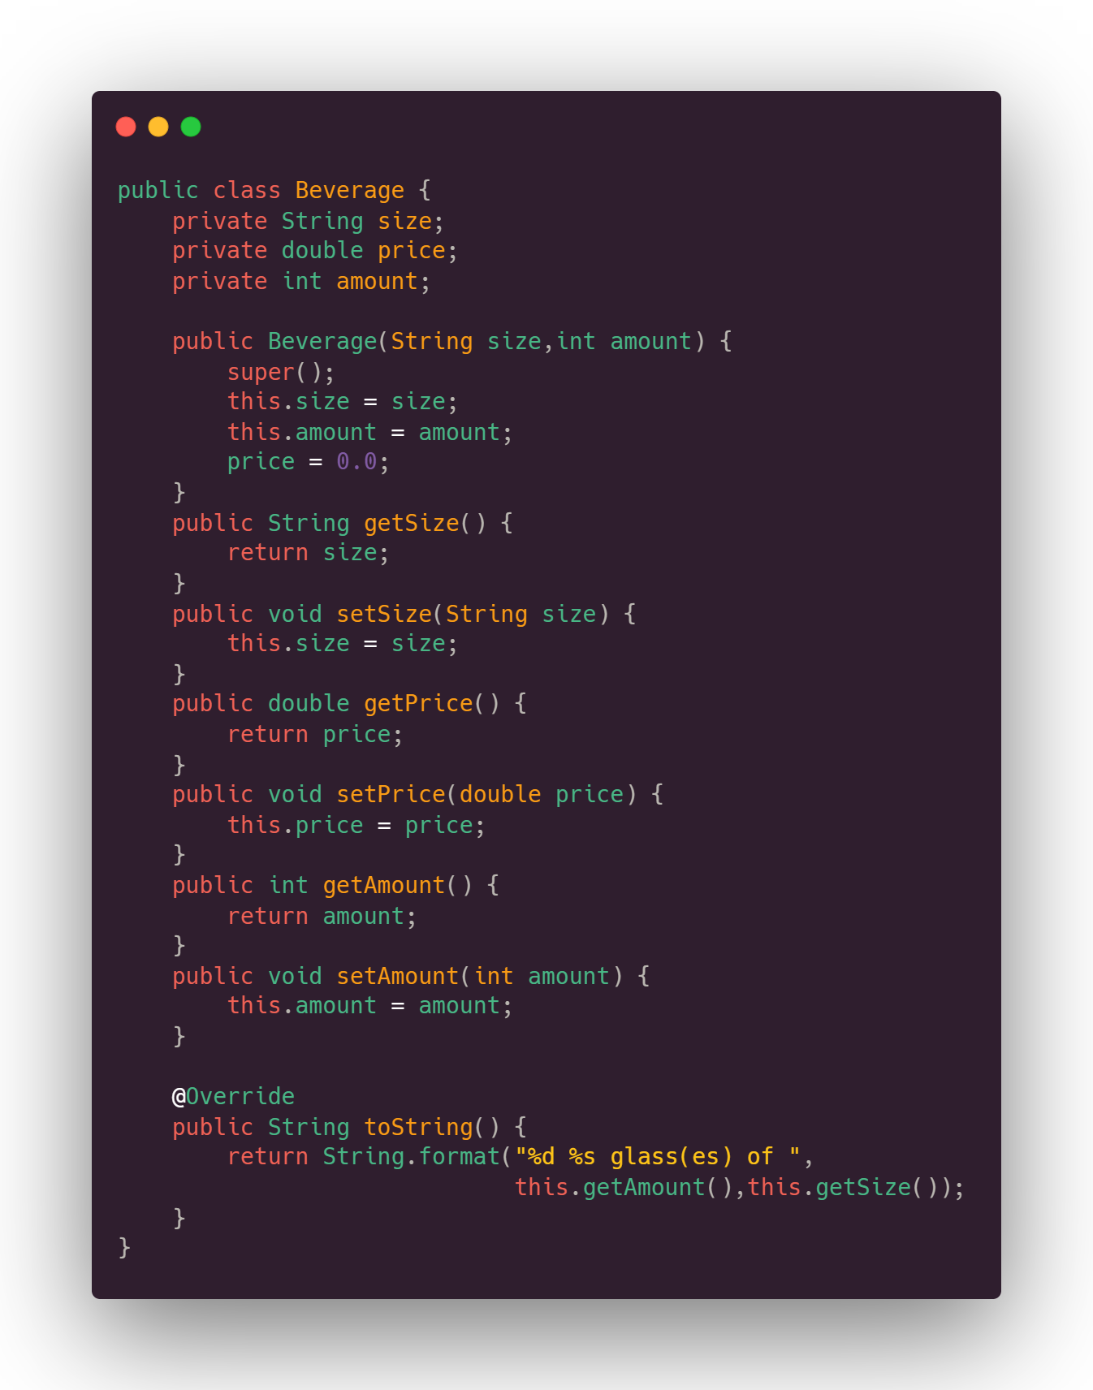
02
Beverages
This class is basically the parent class for all the drinks , it helps with reusability of the code by providing us a blueprint for size , price and amount of a drink

Slide 6
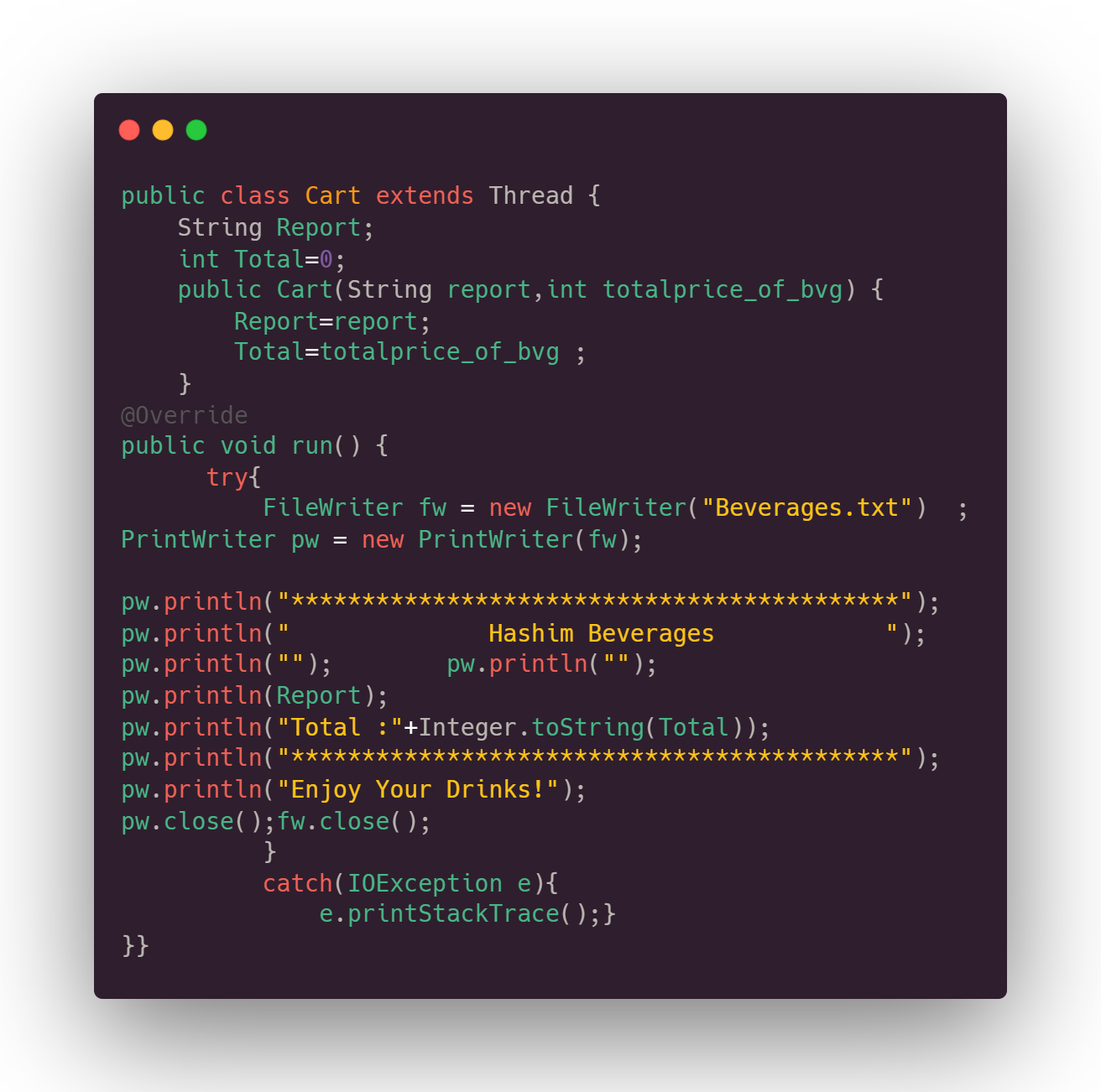
03
Cart Class
This class helps us complete the threading requirement of our program, It prints the receipt for the drinks while keeping the Main UI running and alive incase the user wants to make repetitive purchases.

Slide 7
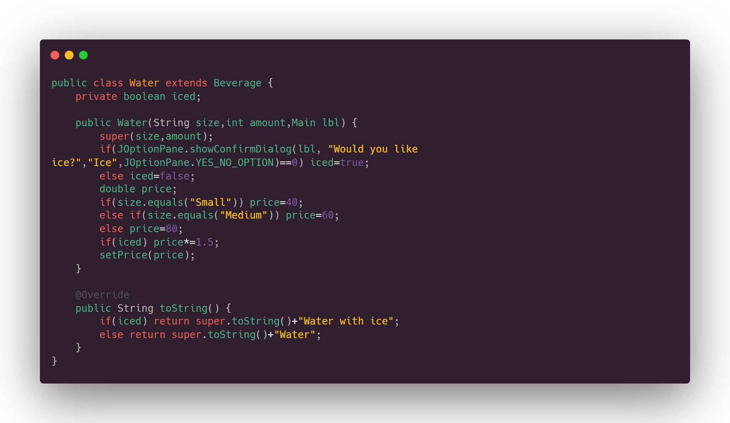
04
Drinks
There are four drinks each with their own classes, Almost everything is same with the classes besides their options
( ice , milk , etc.) and prices.

Slide 8
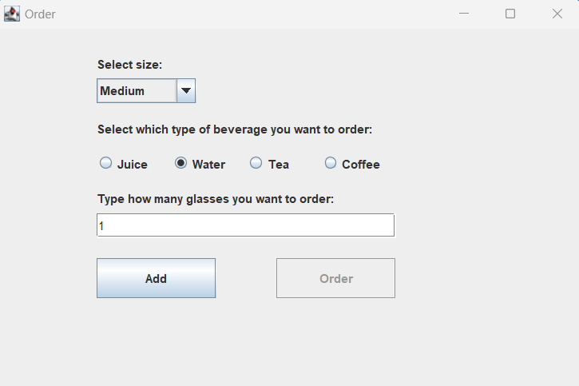
Ordering
Let us Order a Drink! In this Screenshot we have our options selected, Lets proceed!

Slide 9
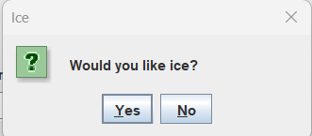
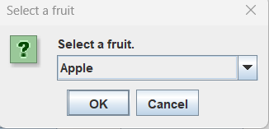
Options!
You can choose whether your drinks have certain Ingredient or not!

Slide 10
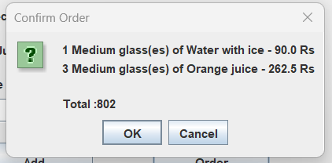
Confirm it!
Make sure your drinks are correct and send our Baristas to work!

Slide 11
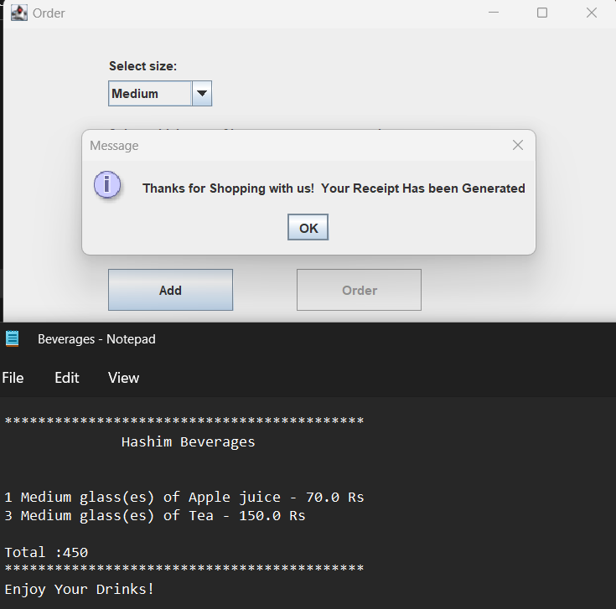
Receipt
You then get a receipt printed in your computer which you can use to prove your purchase and receive your drinks once they are made.

Slide 12
Thanks!
Hope you enjoy your beverages!
-Aashish Kumar (21SW109)

